Slide 1
Re-writing the Map of the Middle East
Lesson 5
Notes:
Light Horse commemorative statue - Photo J Curry

Slide 2
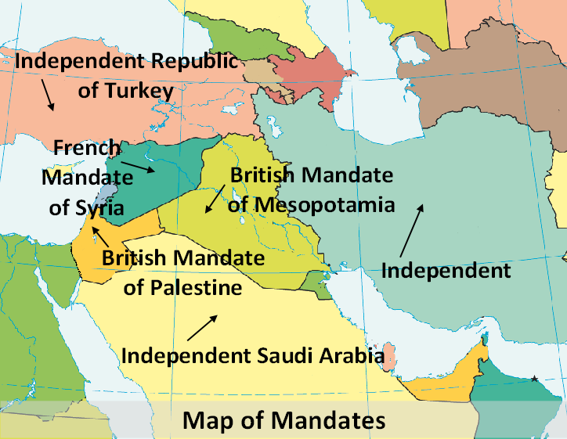
How the Middle East was partitioned
Notes:
Map of mandates – Base map - CIA World Fact Book https://www.cia.gov

Slide 3
League of Nations Mandate – Ratified July1922 San Remo
France – Syria (Syria and Lebanon
Britain - Mesopotamia (Iraq) and Palestine (Jordan and Israel)

Slide 4
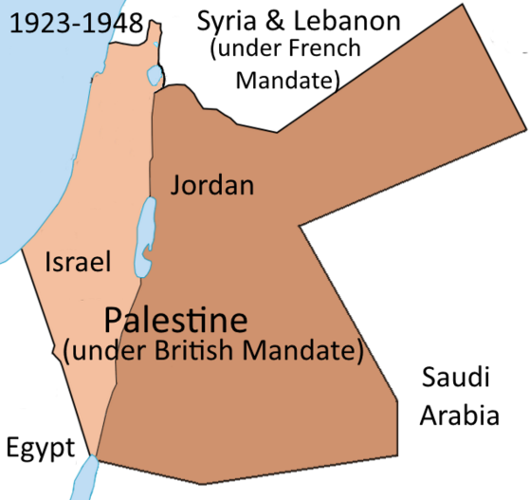
British Mandate over Palestine
Notes:
Map of Partition of Palestine – https://commons.wikimedia.org/wiki/File:PalestineAndTransjordan.png – Doron

Slide 5
How Palestine was divided
Arabs – 77% - Land East of the Jordan River (38,000 square miles). Became Jordan
Jews – 23% - Land West of the Jordan River (8,000 square miles). Became Israel

Slide 6
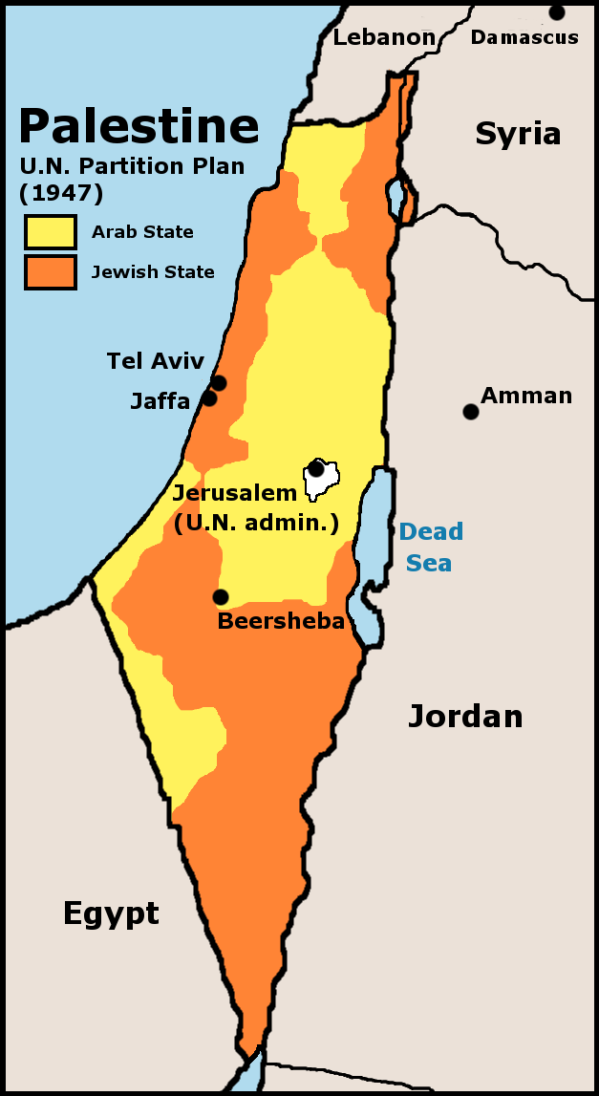
UN Partition Plan 1947
Accepted by Jews
Rejected by all Arab countries
Notes:
http://laopinion2010.blogspot.com.au/p/historia-israel-y-palestina-breve.html

Slide 7
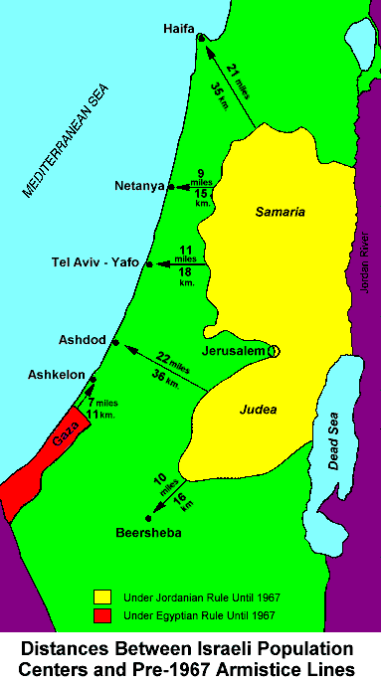
Notes:
http://www.crethiplethi.com/un-security-council-resolution-242/united-nations/un-resolution-242/2009/

Slide 8
Significance of the ANZAC contribution to the campaign
The Allied forces caused an Empire to fall and 6 nations to be born. ANZACs often at the forefront.
The ANZACs put Australia and New Zealand on the world map
They created the ANZAC legend
The experience they gained bred many leaders of the young Australian nation

