Slide 1
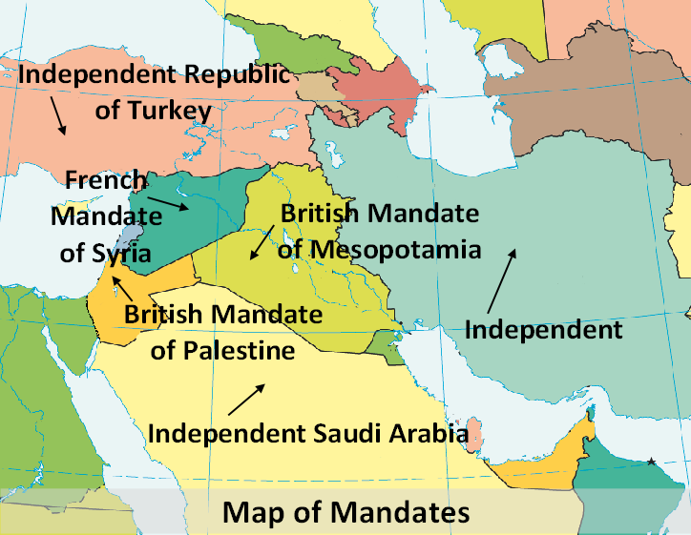
How the Middle East was partitioned
Notes:
Map of mandates – Base map - CIA World Fact Book https://www.cia.gov

Slide 2
League of Nations Mandate – Ratified July1922 San Remo
France – Syria (Syria and Lebanon
Britain - Mesopotamia (Iraq) and Palestine (Jordan and Israel)

Slide 3
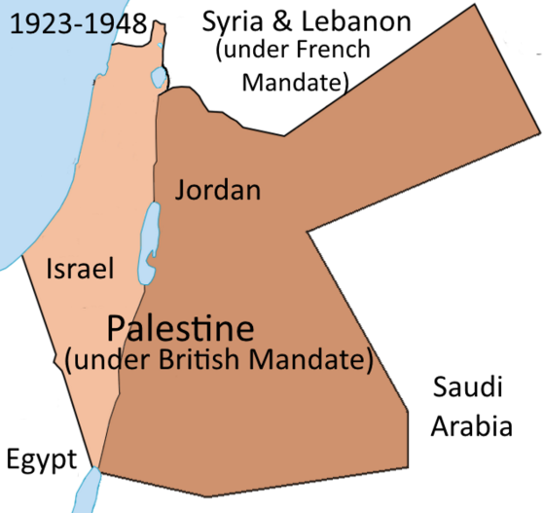
British Mandate over Palestine
Notes:
Map of Partition of Palestine – https://commons.wikimedia.org/wiki/File:PalestineAndTransjordan.png – Doron

Slide 4
How Palestine was divided
Arabs – 77% - Land East of the Jordan River (38,000 square miles). Became Jordan
Jews – 23% - Land West of the Jordan River (8,000 square miles). Became Israel

Slide 5
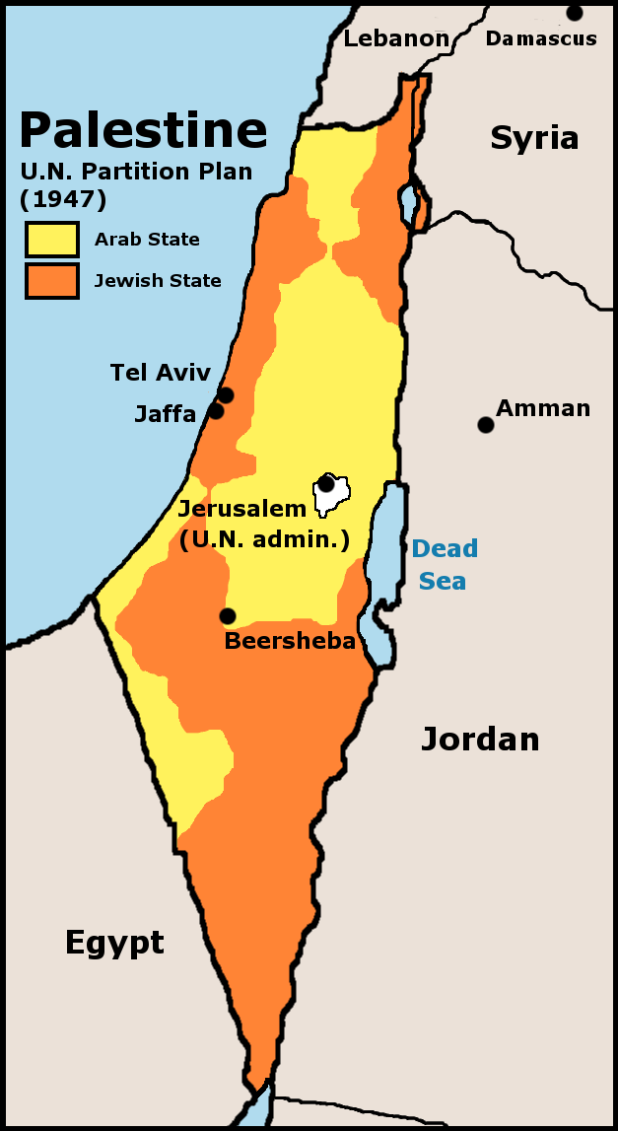
UN Partition Plan 1947
Accepted by Jews
Rejected by all Arab countries
Notes:
http://laopinion2010.blogspot.com.au/p/historia-israel-y-palestina-breve.html

Slide 6
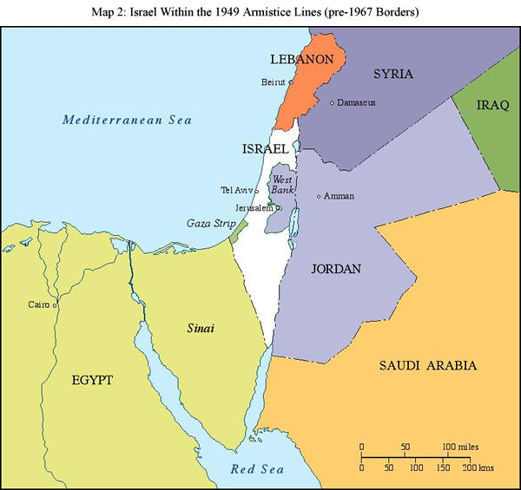
1949-1967 boundaries
Notes:
http://israelvoice.blog.com/2011/06/11/dispatch-from-jerusalem-lets-talk-1967

Slide 7
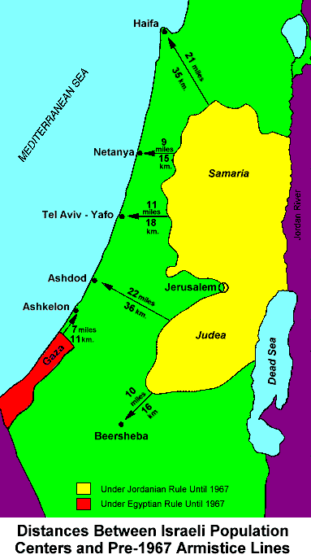
Map showing distances
Notes:
Pre-’67 borders http://anaverageamericanpatriot.blogspot.com.au/2010/12/bolivia-recognizes-palestine-while.html

Slide 8
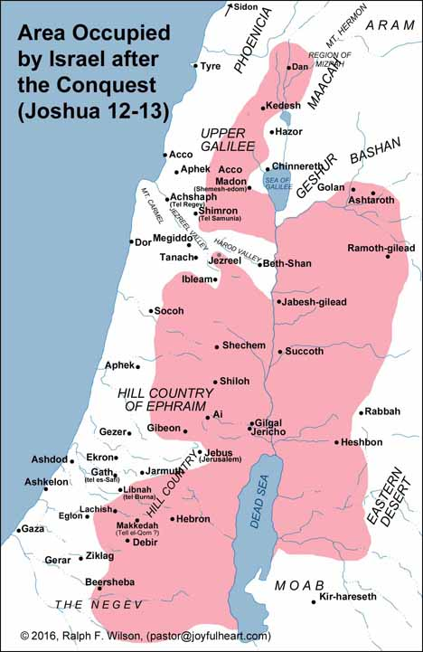
Notes:
Joshua’s conquest - http://www.jesuswalk.com/joshua/6_possessing.htm

Slide 9
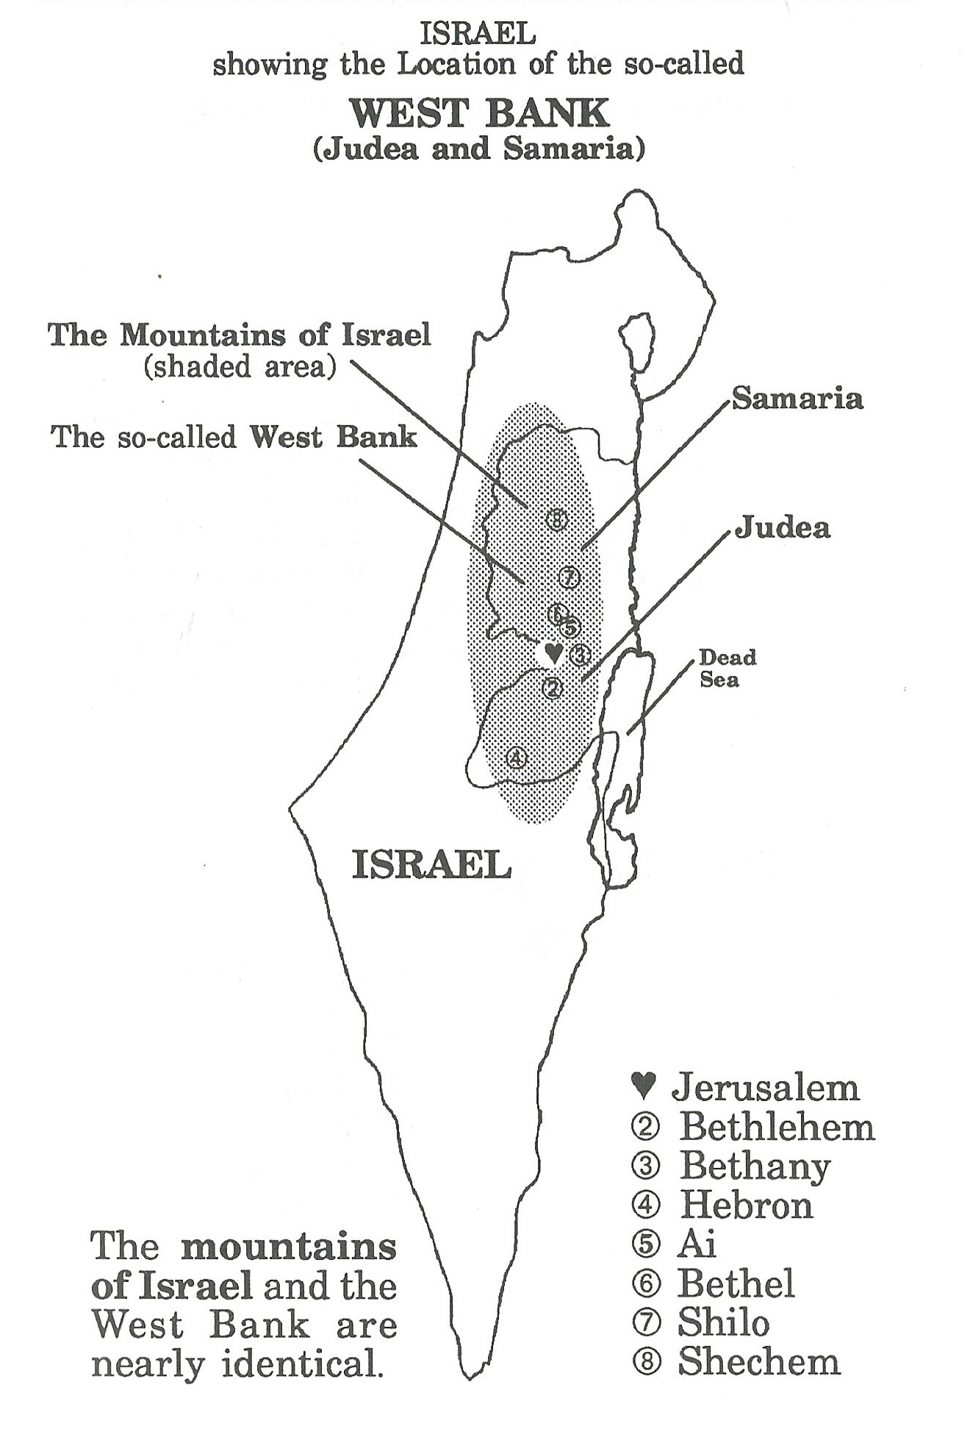
The Mountains of Israel
The West Bank
And the biblical cities
Notes:
Archbold, N., The Mountains of Israel, Phoebe’s Song Pub, 1993, Page 3

Slide 10
Ezekiel 36:23-27 NLT
I will reveal my holiness through you before their very eyes, says the Sovereign Lord, then the nations will know that I am the Lord. ²⁴ For I will gather you up from all the nations and bring you home again to your land.

Slide 11
Then I will sprinkle clean water on you, and you will be clean.... ²⁶ And I will give you a new heart, and I will put a new spirit in you. I will take out your stony, stubborn heart and give you a tender, responsive heart. And I will put my Spirit in you so that you will follow my decrees and be careful to obey my regulations.

Slide 12
Luke 21:23b-24 NLT
For there will be disaster in the land and great anger against this people. ²⁴ They will be killed by the sword or sent away as captives to all the nations of the world. And Jerusalem will be trampled down by the Gentiles UNTIL the period of the Gentiles comes to an end.

Slide 13
Matthew 23:37-39 NLT
O Jerusalem...how often I have wanted to gather your children together...your house is abandoned and desolate. For I tell you this, you will never see me again UNTIL you say, ‘Blessings on the one who comes in the name of the Lord! (Hebrew expression means ‘Welcome’)
Notes:
Hen and chicks http://www.christcenteredmall.com/stores/art/swindle/i-would-gather-thee-as-a-hen-gathereth-her-chicks.htm

Slide 14
Significance of the ANZAC contribution to the campaign
The Allied forces caused an Empire to fall & 6 nations to be born. ANZACs often at the forefront.
The ANZACs put Australia and New Zealand on the world map
They created the ANZAC legend
They advanced the fulfilment of Biblical prophecy

