Slide 1
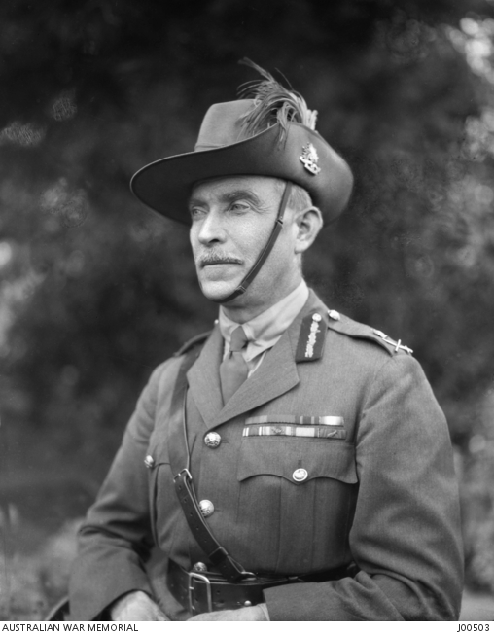
General Sir Harry Chauvel
Commander of the Desert Mounted Corps
Notes:
Harry Chauvel in 1923 https://www.awm.gov.au/collection/J00503/

Slide 2
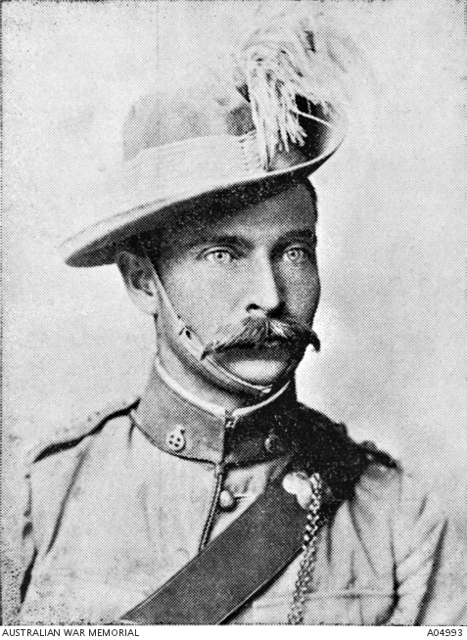
Chauvel as a young man
Notes:
Harry Chauvel as a young man in the Queensland Mounted Infantry https://www.awm.gov.au/collection/A04993/

Slide 3
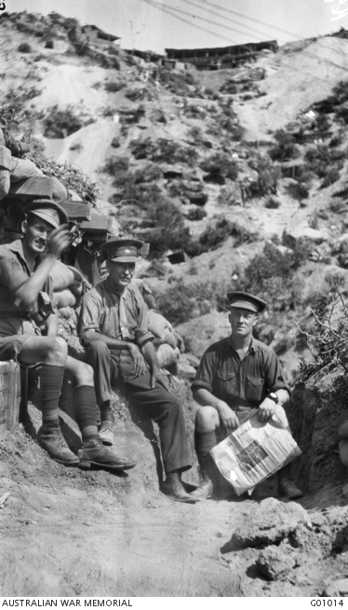
GAllipoli
Chauvel led the 1st Light Horse Brigade in Gallipoli
Notes:
Australian War Memorial https://www.awm.gov.au/collection/G01014/ Photo by Charles Bean. Gallipoli Peninsula, Turkey. 1915. General Chauvel with Major E.M. Williams, Brigade Major of the 1st Australian Light Horse (left) and Staff Captain Walter Percy Farr (right).

Slide 4
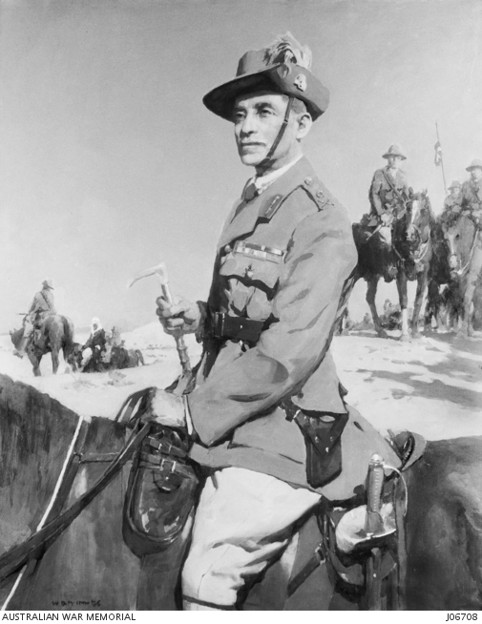
In the Sinai dEsert
Notes:
Australian War Memorial https://www.awm.gov.au/collection/J06708/ Sir Harry Chauvel. Portrait by McInnis.

Slide 5
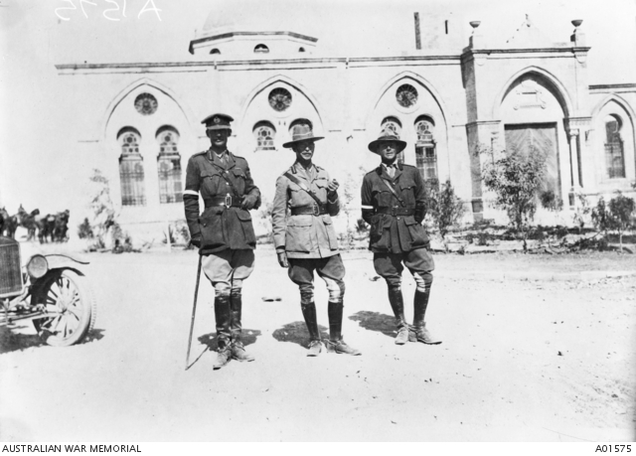
The day after capturing beersheba
Notes:
Australian War Memorial https://www.awm.gov.au/collection/A01575/ General Sir H G Chauvel GOC, Desert Mounted Corps (centre) with Brigadier General R G H Howard-Vyse CMG DSO, his Brigadier General, General Staff (BGGS) (left) and Captain W G Lyons MC (right), one of his Aide de Camps (ADC). Photo taken the day after the capture of Beersheba.

Slide 6
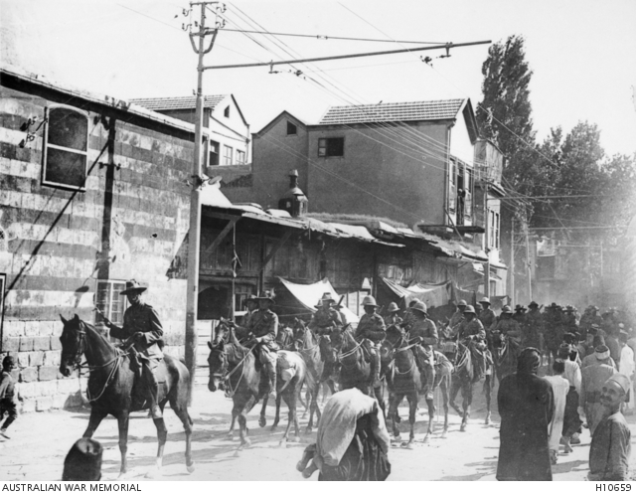
damascus
Notes:
Chauvel leading the troops through Damascus https://www.awm.gov.au/collection/H10659/

Slide 7
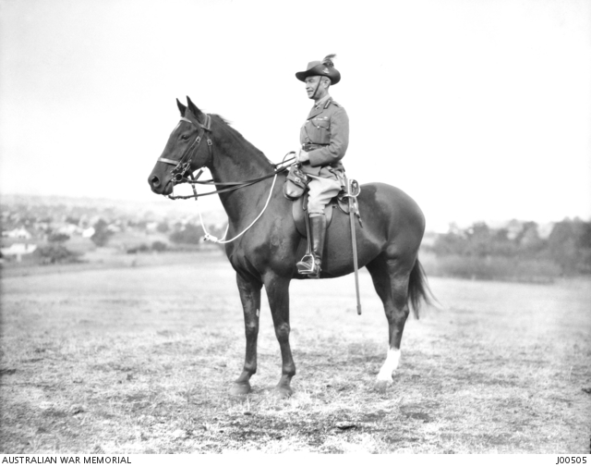
Inspector general of the army
Notes:
Chauvel on horse Maribyrnong 1923. https://www.awm.gov.au/collection/J00505/

Slide 8
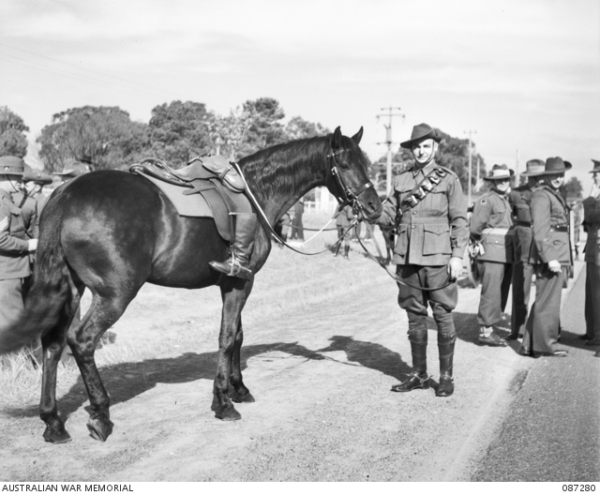
Chauvel’s funeral
Boots in reverse mean fallen soldier not returning
Notes:
Australian War Memorial https://www.awm.gov.au/collection/087280/ Photo John Lee.
Sir Harry Chauvel's horse with the rider's boots set in reverse.

