Slide 1
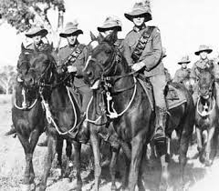
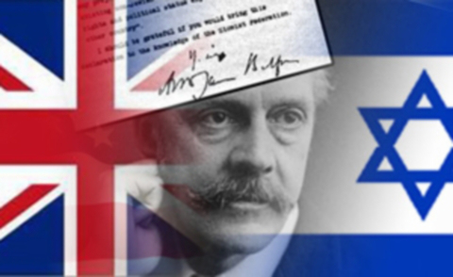
October 31 2017 A date to remember
Light Horse breakthrough at Beersheva
Balfour Declaration
Notes:
Light Horse Troop - http://clangrantaus.com/australia/australian-military-history/australian-lighthorse/
https://morgenwacht.wordpress.com/2016/05/24/der-hintergrund-des-verrats-1-die-balfour-deklaration/

Slide 2
4th Light Horse at Beersheba
Notes:
Australian War Memorial https://www.awm.gov.au/collection/P02268.012 4th Light Horse at Beersheba

Slide 3
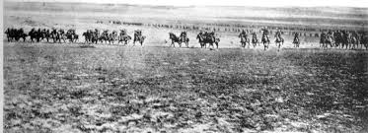
Charge of the Light Horse
Notes:
Disputed picture of the charge at Beersheba (or re-enactment) – Australian War memorial https://www.awm.gov.au/collection/A02684/ It was probably taken when two regiments of the 4th Brigade, Australian Light Horse, re-enacted the charge for the official photographer Frank Hurley, at Belah on 7 February 1918.

Slide 4
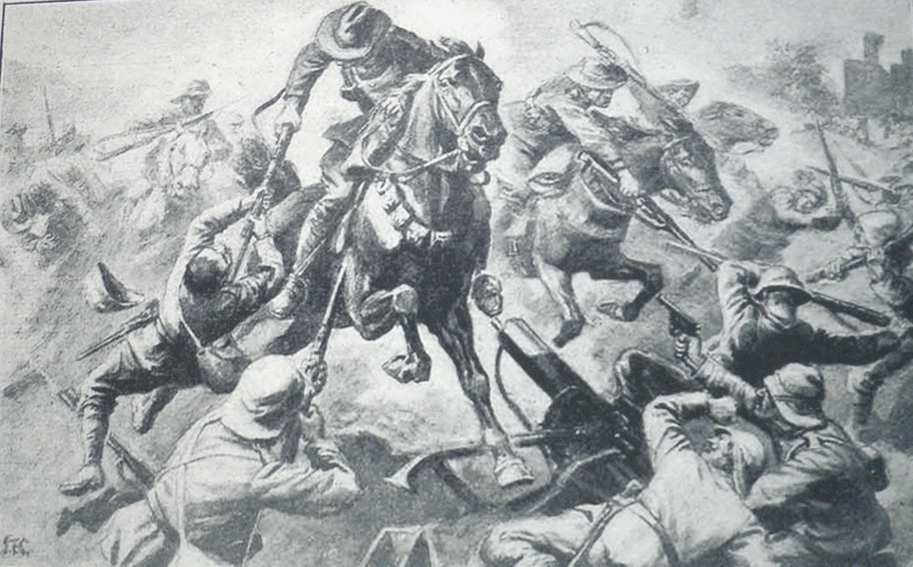
Jumping the trenches
Notes:
Jumping the trenches – from a photograph at an exhibition in Beersheba in 2012

Slide 5
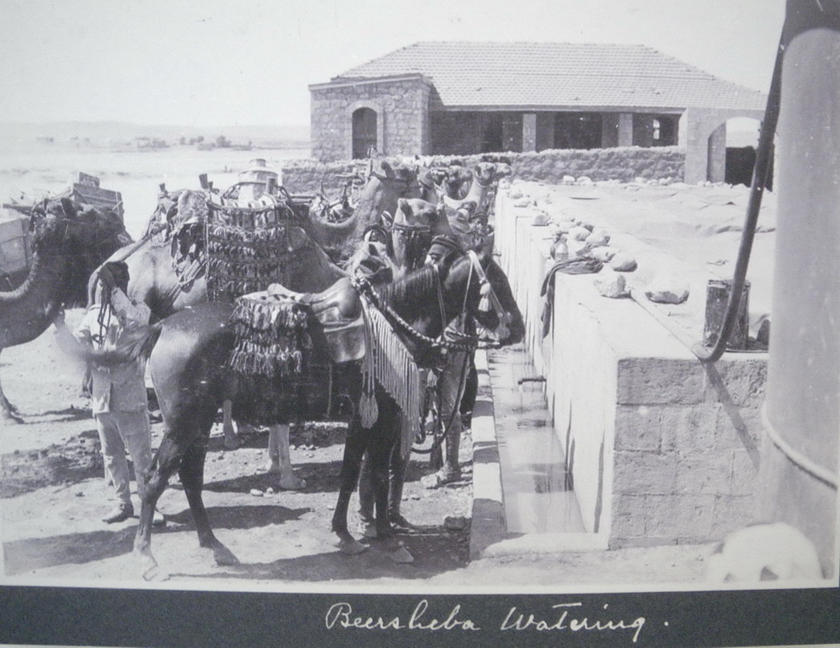
Wells at Beersheba
Notes:
Watering the Horses at Beersheba - from a photograph at an exhibition in Beersheba in 2012

Slide 6
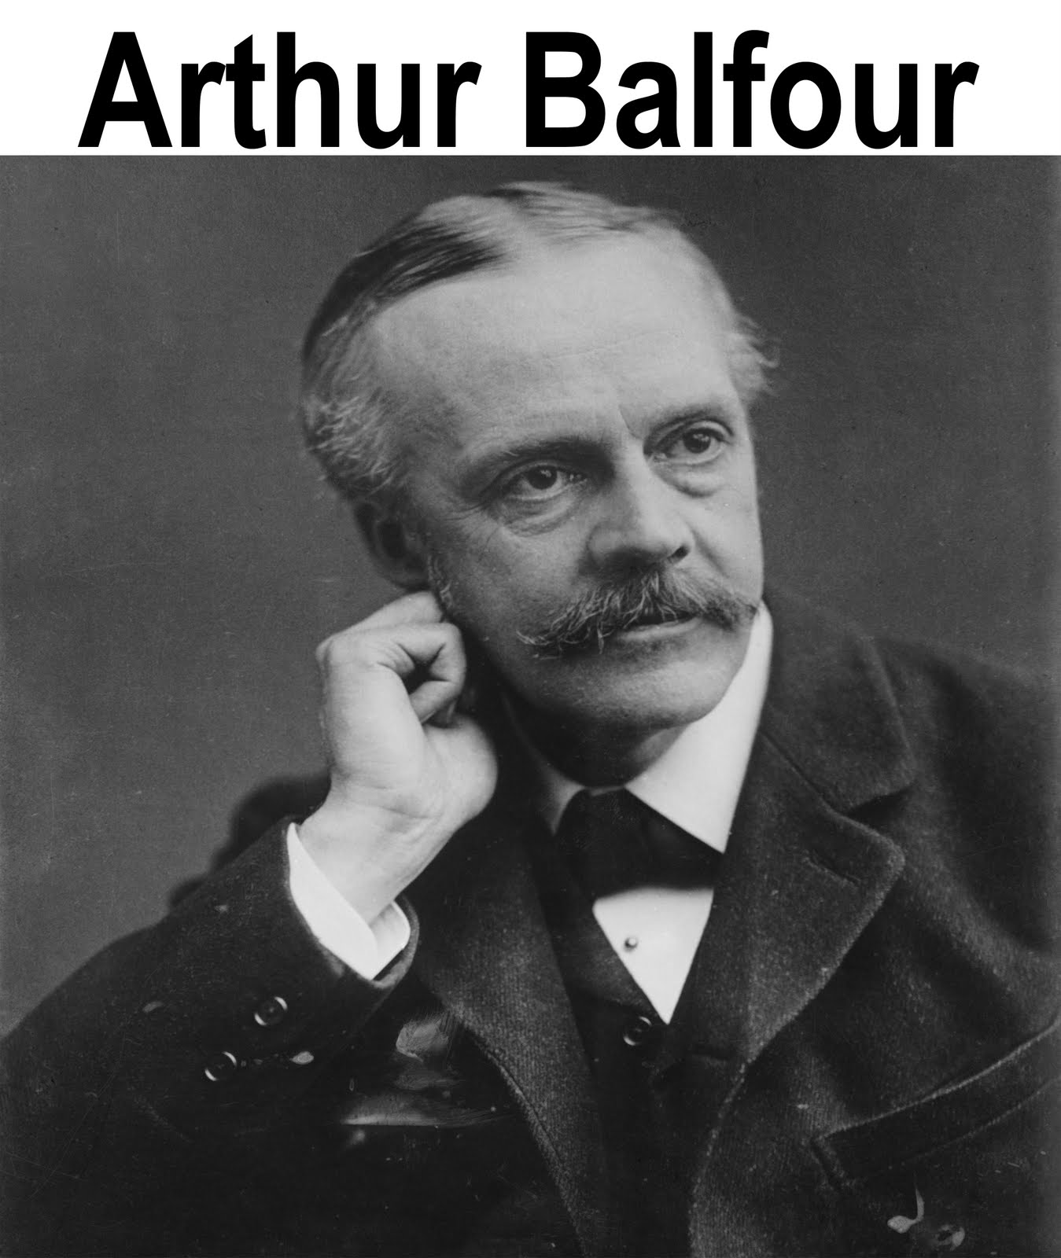
Lord Balfour
Foreign Secretary in British Prime Minister David Lloyd George’s coalition
Notes:
Arthur Balfour http://speedymedia.blogspot.com.au/2010/12/san-remo-conference.html

Slide 7
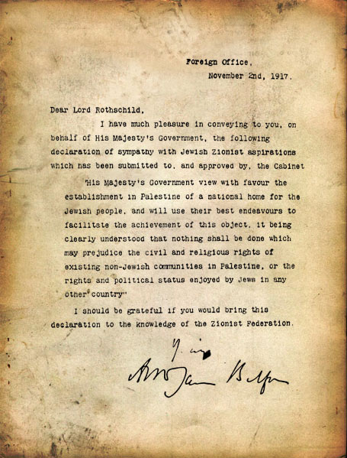
Balfour Declaration
His Majesty’s Government views with favour the establishment in Palestine of a National Home for the Jewish people
Notes:
Balfour declaration http://israelforever.org/state/balfour_declaration_original/

Slide 8
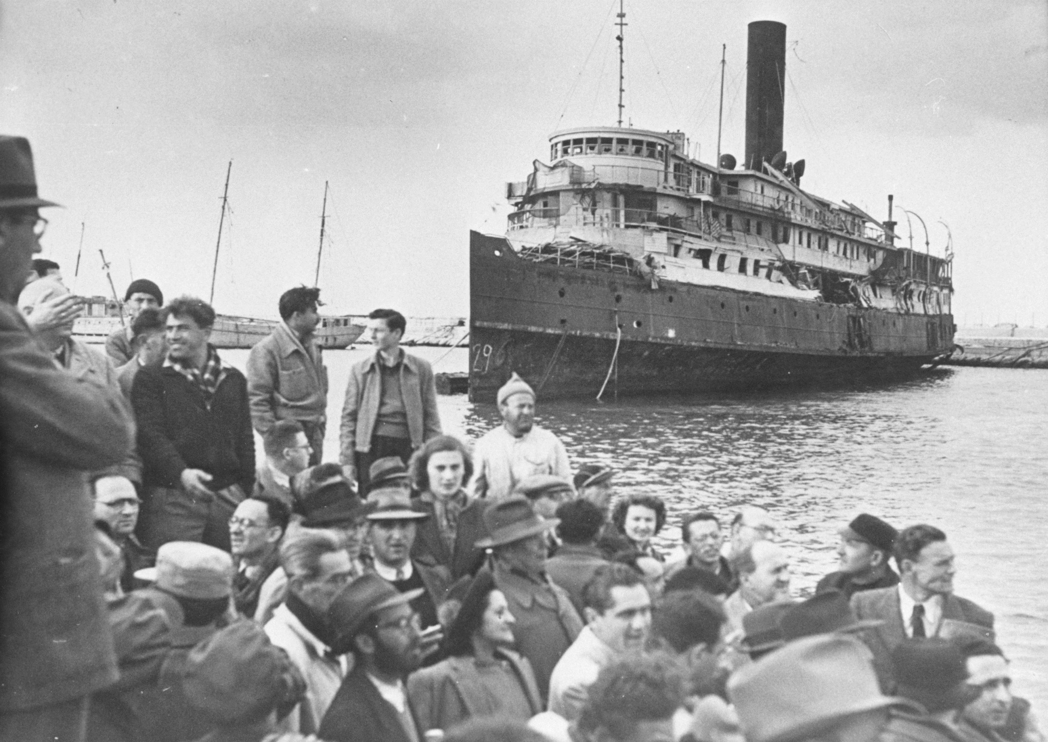
Jews return home
Notes:
Jews return home from Buchenwald http://gcaptain.com/maritime-monday-june-ten-twntythrteen-exodus/

Slide 9
Israel becomes a nation again
Notes:
Independence Hall Tel Aviv – J. Curry

