Slide 1
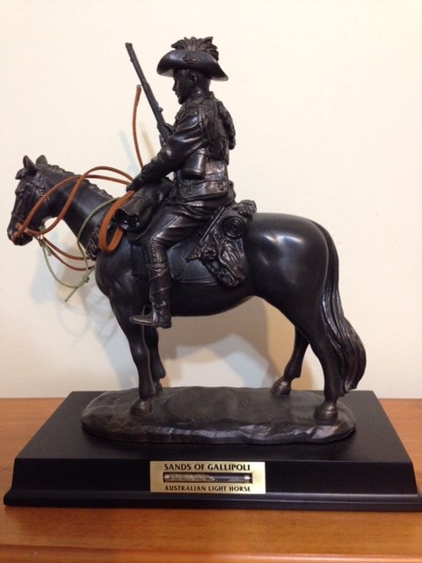
Breakthrough at Beersheba
Lesson 3
Notes:
Light Horse commemorative statue - Photo J Curry

Slide 2
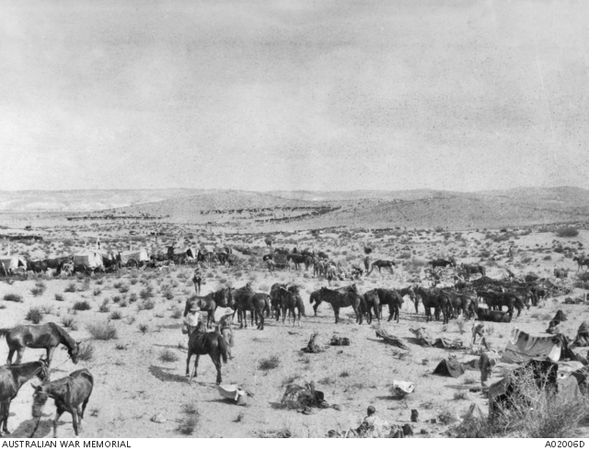
Before the Beersheba charge
Notes:
Before the Charge Australian War memorial https://www.awm.gov.au/collection/A02006D

Slide 3
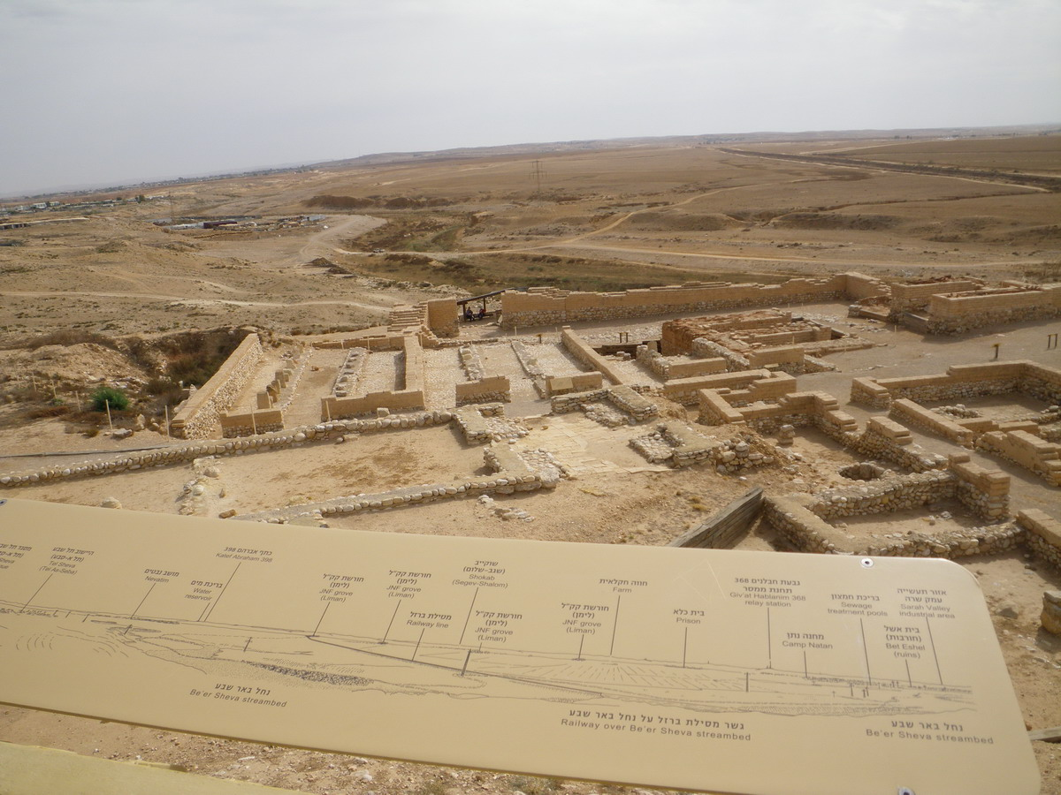
View from Tel el Saba – across the plain where Light Horse charged
Notes:
View from Tel el Saba over the plain where the Light Horse charged – J Curry

Slide 4
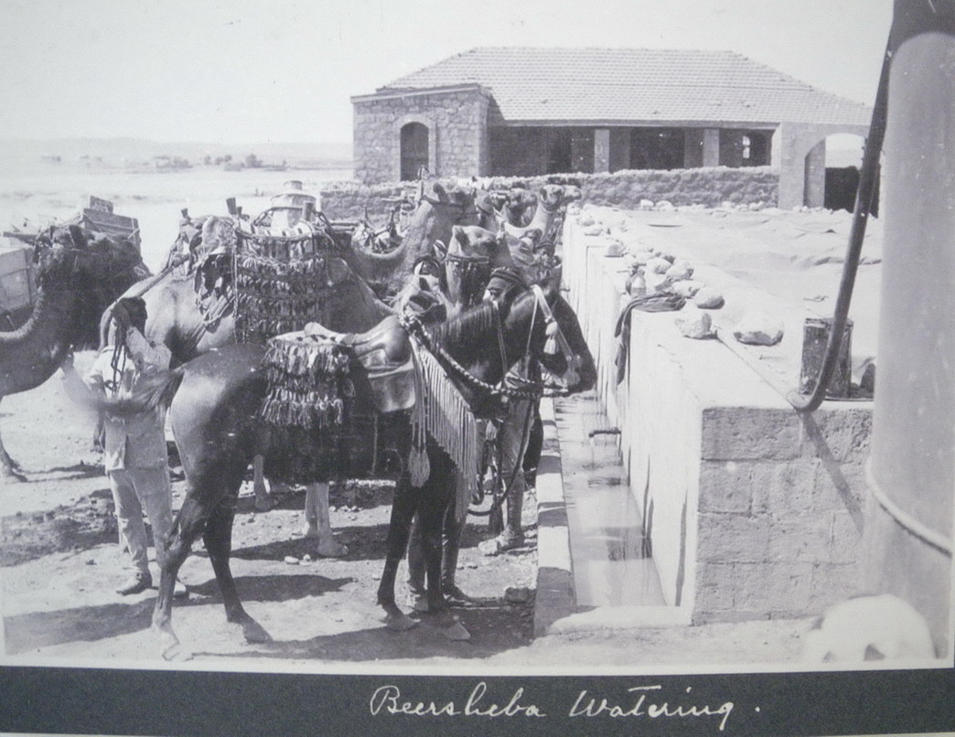
Notes:
Beersheba Watering – from an exhibition at Be’er Sheva in 2012

Slide 5
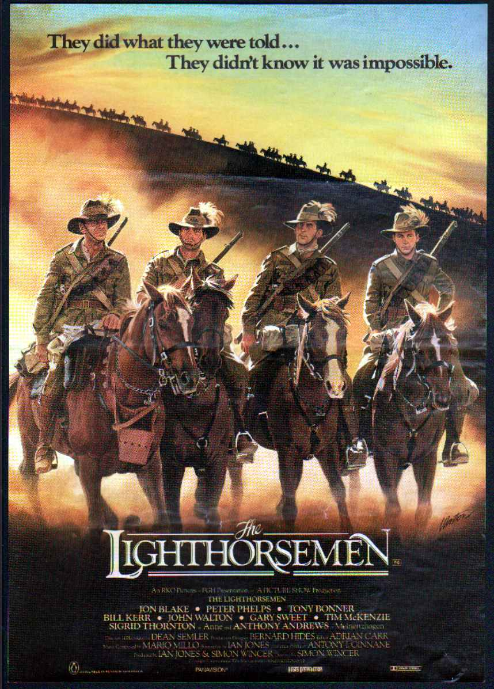
1987 Light Horsemen movie cover
Notes:
The Lighthorsemen movie cover - http://www.franklycollectible.com/product_info.php/the-lighthorsemen-movie-flyer-film-original-oz-1987-gary-sweet-p-2425

Slide 6
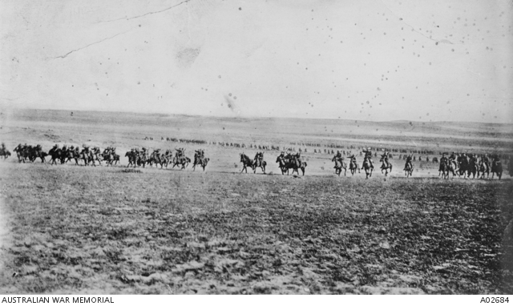
The Light Horse Charge
Notes:
Disputed picture of the charge at Beersheba (or re-enactment) – Australian War memorial https://www.awm.gov.au/collection/A02684/ It was probably taken when two regiments of the 4th Brigade, Australian Light Horse, re-enacted the charge for the official photographer Frank Hurley, at Belah on 7 February 1918.

Slide 7
Midnight’s Last Charge - Painting by Jennifer Marshall
Notes:
Midnight’s Last Charge – painting by Jennifer Marshall www.lighthorseart.com.au. Midnight died and her rider Guy Haydon was injured in the charge.

Slide 8
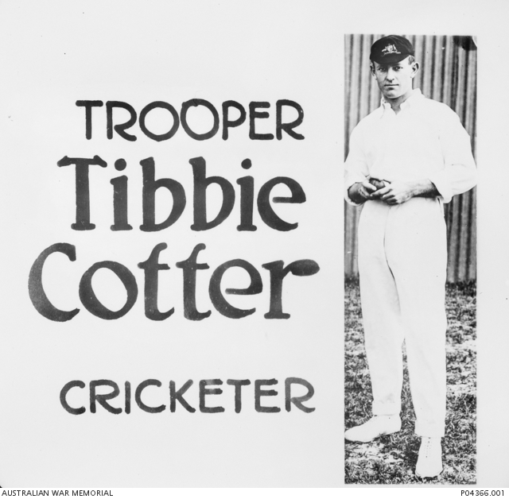
Notes:
Tibbie Cotter – recruitment poster https://www.awm.gov.au/collection/P04366.001

Slide 9
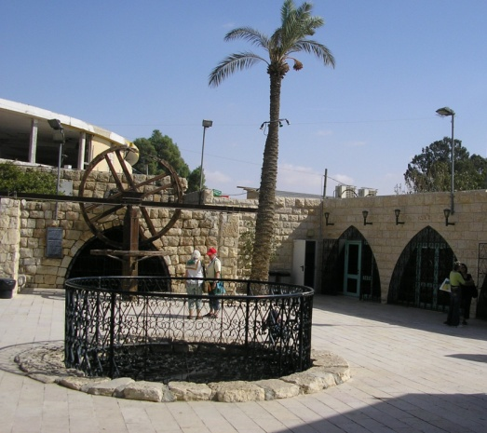
Abraham’s Well restored at Beersheva
Notes:
Abraham’s Well tourist site, Beersheva, Israel (before latest reconstruction) – J Curry

Slide 10
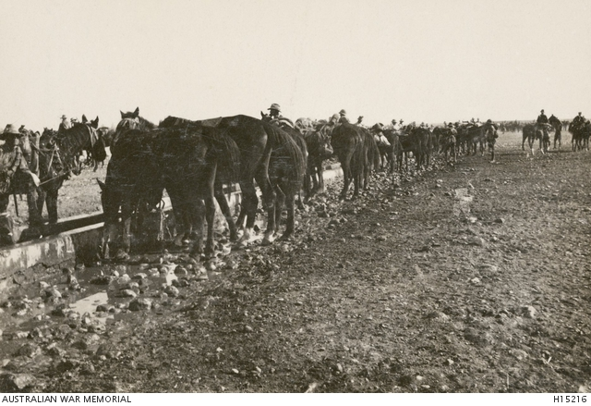
Watering the Horses - Beersheba
Notes:
Watering the 12 LH horses, Beersheba. Australian War Memorial https://www.awm.gov.au/collection/H15216

Slide 11
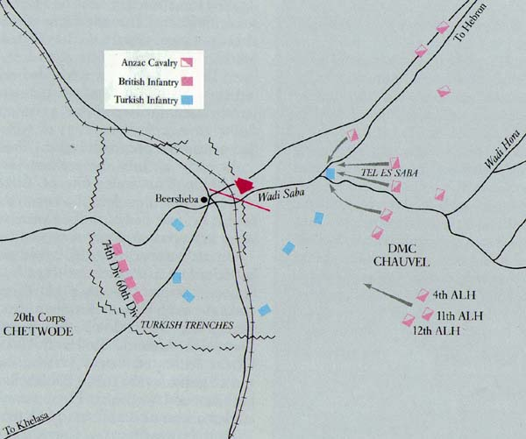
Notes:
Map of Beersheba – https://en.wikipedia.org/wiki/Battle_of_Beersheba_(1917)

Slide 12
The ‘madmen’ prevailed – the Last Great Cavalry Charge in history
800 courageous horsemen against 4,000 entrenched Turks with machine guns, artillery and German bombers
Speed and surprise won the battle (no dismount)
Military victory and morale booster
31 died, 36 wounded, and 70 horses lost
The same day, Oct 31, 1917 the British War cabinet met and decided to allow the Jewish people to return and give them a homeland in part of Palestine in their ancestral territory

Slide 13
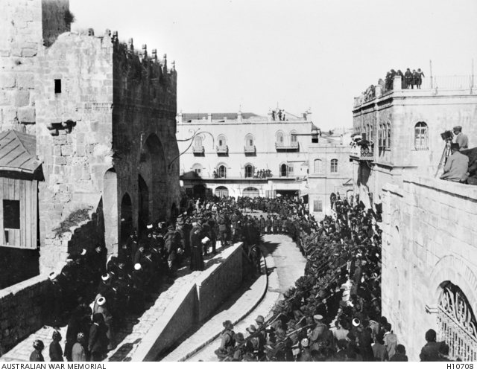
The official handover of Jerusalem December 11, 1917
Notes:
Jerusalem surrendered – Australian War Memorial https://www.awm.gov.au/collection/H10708/

Slide 14
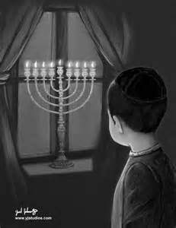
Channukka
Maccabees’ victory over Greeks
– Feast of Dedication
– Festival of Lights
Notes:
Chanuka lights - http://imgarcade.com/1/chanukah-menorah-in-window/

Slide 15
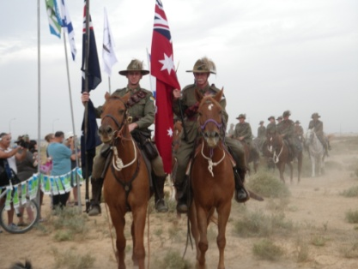
90th Anniversary
Commemorations
Be’er Sheva
2007
Notes:
90th Anniversary celebration of the Battle of Beersheba – J Curry

