Slide 1
Strategy in War
Notes:
http://www.5elementsrpo.com/2012/11/nature-of-strategies-and-strategic-management/

Slide 2
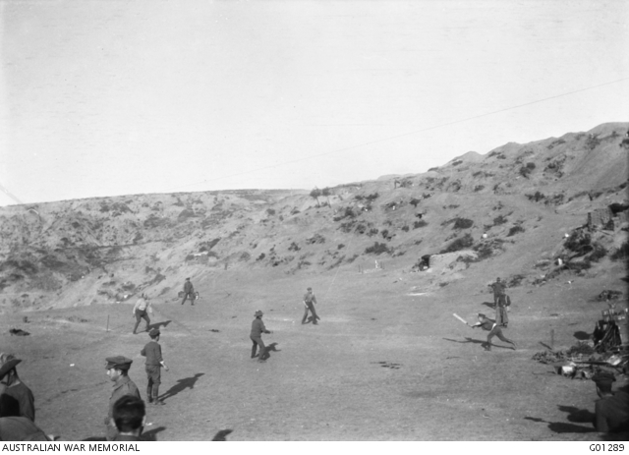
Diversion tactics
A cricket match was played as the troops prepared to leave Gallipoli
Notes:
Australian War Memorial https://www.awm.gov.au/collection/G01289/, Photo by Charles Bean, Dec 17, 1915.

Slide 3
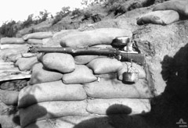
The drip or ‘pop off’ rifle
The rifle, triggered by dripping water continued to fire after the troops had left
Notes:
https://www.awm.gov.au/encyclopedia/gallipoli/drip_rifle/

Slide 4
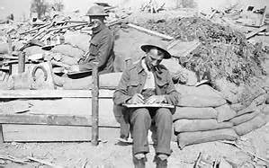
Letter dropped
Beersheba impossible due to lack of water
Next attack has to be at Gaza again
Notes:
Letter – Imperial War Museum http://www.telegraph.co.uk/history/world-war-one/inside-first-world-war/part-ten/10863689/why-first-world-war-letters-censored.html
http://folegattiadvocacia.com.br/css/an-old-envelope

Slide 5
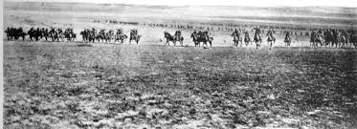
Surprise – charge!
Light Horse troops normally dismounted then fought on foot. At Beersheba they did not stop.
Notes:
Disputed picture of the charge at Beersheba (or re-enactment) – Australian War memorial https://www.awm.gov.au/collection/A02684/. It was probably taken when two regiments of the 4th Brigade, Australian Light Horse, re-enacted the charge for the official photographer Frank Hurley, at Belah on 7 February 1918.

Slide 6
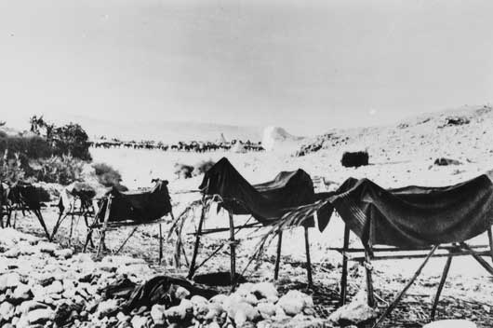
Dummy horses to confuse aircraft
Notes:
Dummy horses used to fool German aircraft – Australian War Memorial
https://www.awm.gov.au/collection/B02667/

Slide 7
Winning the battle
Winning is not always about the greatest talent or the biggest army.
It takes ingenuity and strategy, then preparation and discipline to carry out the plan successfully.
Notes:
https://www.dreamstime.com/royalty-free-stock-image-vision-strategy-plan-text-d-red-blue-green-arrows-image29799516

