Slide 1
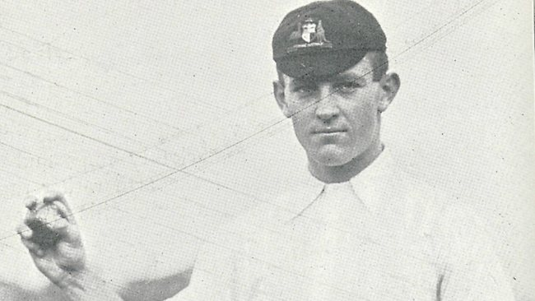
Albert ‘Tibby’ Cotter
The Australian cricketer who survived Gallipoli but died in the battle of Beersheba.
Notes:
http://www.theaustralian.com.au/in-depth/anzac-day/wwi-death-of-test-hero-albert-tibby-cotter-revealed/news-story/6d86bacde0f5bc84ce5cae292b2c8833

Slide 2
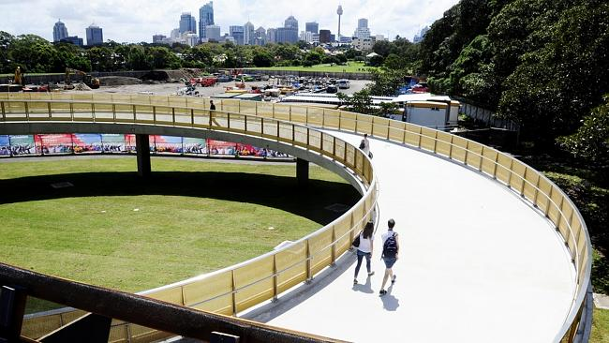
Albert ‘Tibby’ Cotter walkway, Sydney
Notes:
Tibby Cotter Walkway. Picture John Appleyard http://www.dailytelegraph.com.au/newslocal/city-east/13m-albert-tibby-cotter-bridge-budget-blowout-under-investigation/news-story/fd74ad199d87c29ec301cdf68add1d6e

Slide 3
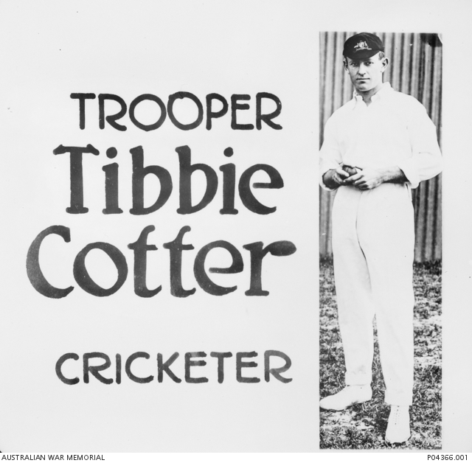
World War I recruitment poster
Notes:
Tibbie Cotter WW1 recruitment poster - https://www.awm.gov.au/collection/P04366.001

Slide 4
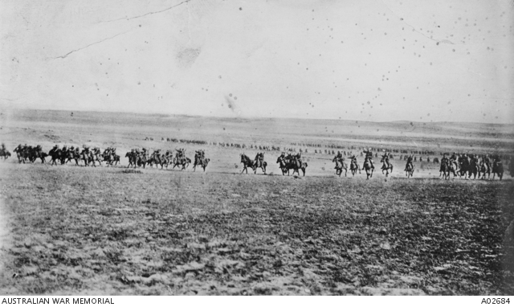
The Light Horse Charge at Beersheba
Notes:
Disputed picture of the charge at Beersheba (or re-enactment) – Australian War memorial https://www.awm.gov.au/collection/A02684/ It was probably taken when two regiments of the 4th Brigade, Australian Light Horse, re-enacted the charge for the official photographer Frank Hurley, at Belah on 7 February 1918.

Slide 5
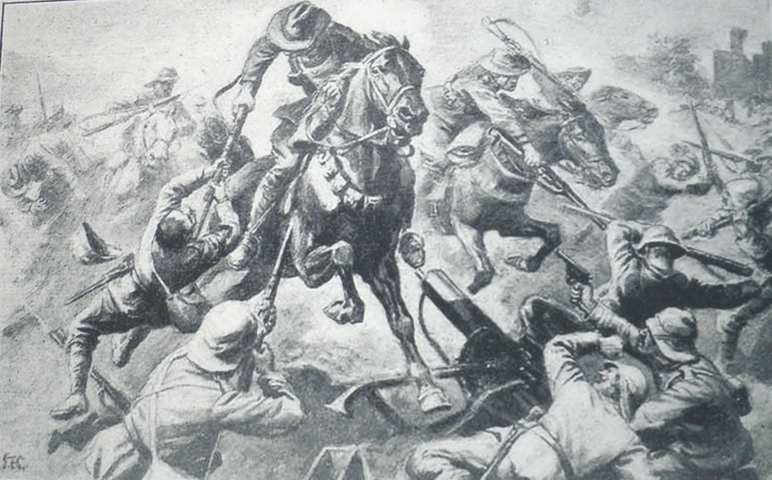
Jumping the trenches
Notes:
Jumping the trenches – from a photograph at an exhibition in Beersheba in 2012

Slide 6
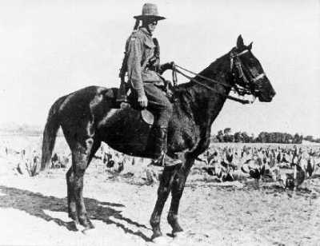
‘Scotty’ Bolton
Notes:
Sloan ‘Scotty’ Bolton and Monty - https://anzacday.org.au/trooper-sloan-scotty-bolton-dcm

Slide 7
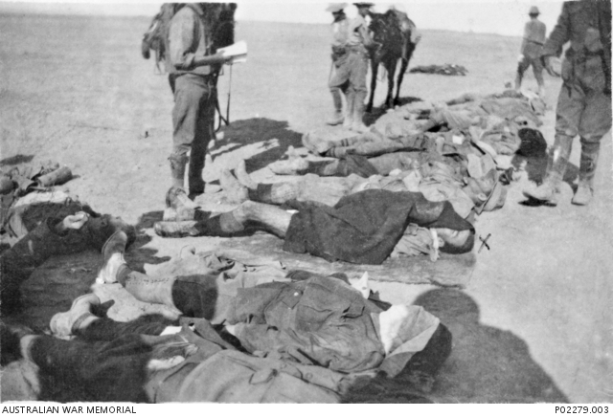
Counting the cost – Cotter marked X
Notes:
Counting the dead https://www.awm.gov.au/collection/P02279.003 One marked X is believed to be Tibbie Cotter.

Slide 8
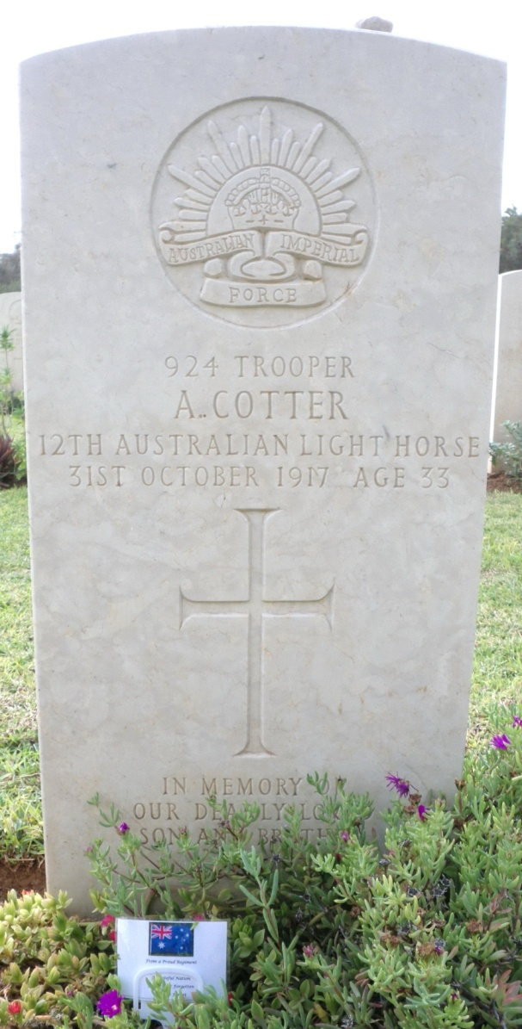
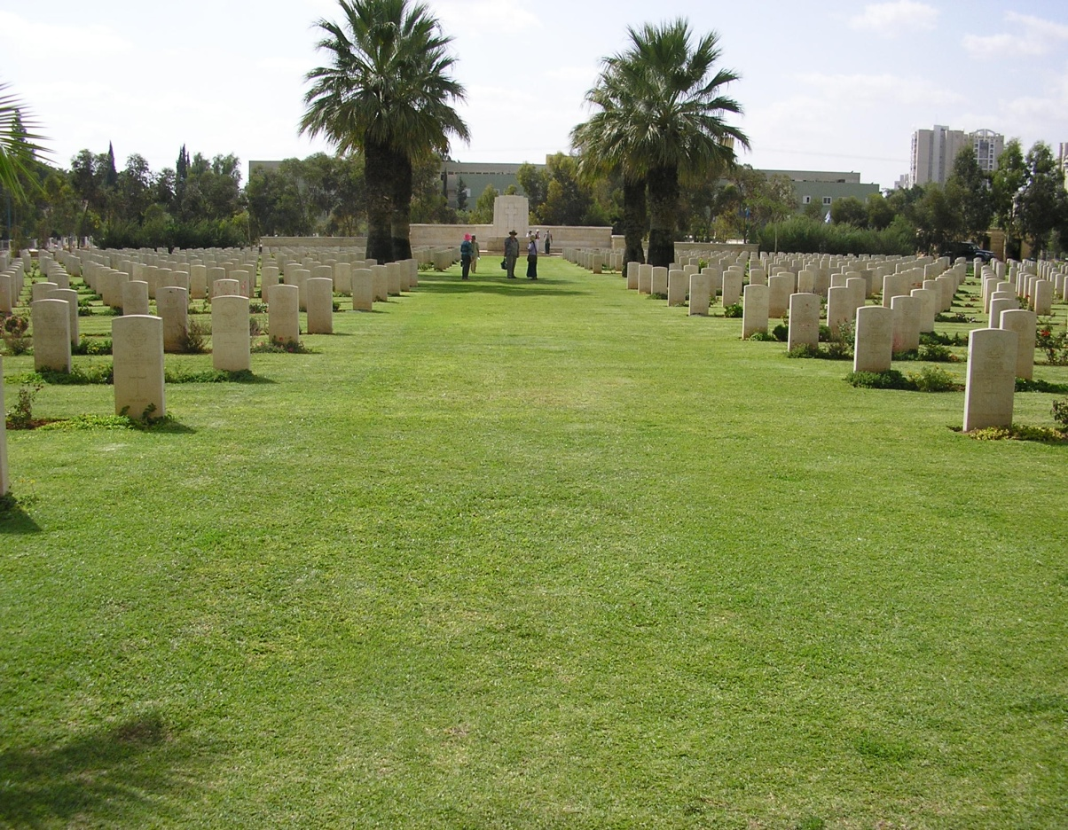
Cotter’s grave, Be’er Sheva cemetery
Notes:
Cotter’s grave, Be’er Sheva Cemetery – J Curry
Be’er Sheva Commonwealth War Graves cemetery – J Curry

Slide 9
Significance of Beersheba victory
Turned the tide of the war in the Middle East
Ultimately led to the collapse of the Ottoman Empire
Paved the way for the taking of Gaza, Jerusalem and the whole of the ancient Holy Land and the unfolding of many biblical prophecies
The Allied victory led to the creation of the present day nations of Israel, Jordan, Lebanon and Syria
The courage of these ‘madmen’ sent fear into the Turks.
Created ANZAC legend and etched the Light Horse in the annals of history.

